Slide 1
BIG DATA HADOOP
By KHATHIJA F KUBRA

Slide 2
BIG DATA
Big data is a term that describes the large volume of data – structured, unstructured and semi structured.
It’s not the amount of data that’s important. It’s what organizations do with the data that matters.
Big data can be analyzed for better insights that lead to better decision making and strategic business moves.

Slide 3
7 V’s of BIG DATA
Volume -Volume is how much data we have
Velocity-Velocity is the speed in which data is accessible.
Variety- structured, unstructured and also many different types of data from XML to video to SMS. Organizing the data in a meaningful way is no simple task, especially when the data itself changes rapidly.
Veracity-Veracity is all about making sure the data is accurate
Variability- when the data is constantly changing it can have a huge impact on your data homogenization.
Value- the value received by the organization from the data.
Visualization-Using charts and graphs to visualize large amounts of complex data is much more effective.

Slide 4
APACHE HADOOP
Apache Hadoop is an open source software platform for distributed storage and distributed processing of very large data sets on computer clusters built from commodity hardware.
It is a network of many computers used to solve problems involving massive amounts of data and computation.
Hadoop services provide for data storage, data processing, data access, security, and operations.

Slide 5
Apache Hadoop framework Modules
Hadoop common – contains libraries and utilities needed by other Hadoop modules
Hadoop Distributed File System (HDFS) – a distributed file-system that stores data on commodity machines.
Hadoop YARN/MapReduce – introduced in 2012 is a platform responsible for resource management and job scheduling technology.

Slide 6
BENEFITS
One of the reasons organizations use Hadoop is its ability to store, manage and analyze vast amounts of structured and unstructured data quickly, reliably, flexibly and at low-cost.
Scalable-hadoopis a highly scalable storage platform, because it can store and distribute very large data sets across hundreds of inexpensive servers that operate in parallel.
Low Cost – unlike proprietary software, Hadoop is open source and runs on low-cost commodity hardware.
Flexibility- can access both structured and unstructured data.
Fast- Hadoop's unique storage method is based on a distributed file system that basically maps data wherever it is located on a cluster.
Resilient to failure-A key advantage of using Hadoop is its fault tolerance. When data is sent to an individual node, that data is also replicated to other nodes in the cluster.

Slide 7
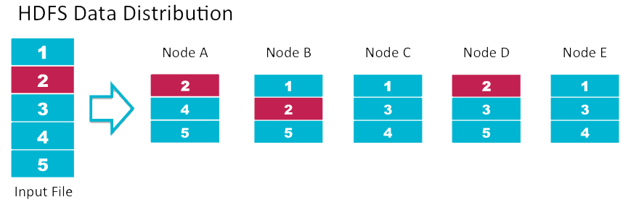
HADOOP DISTRIBUTED FILE SYSTEM
HDFS is responsible for storing data on the cluster.
Data files are split into blocks and distributed across the nodes in the cluster.
Each block is replicated three times.
The data is split into blocks and is stored in different data nodes. And the data of each block is stored in the Name node called the meta data.

Slide 8
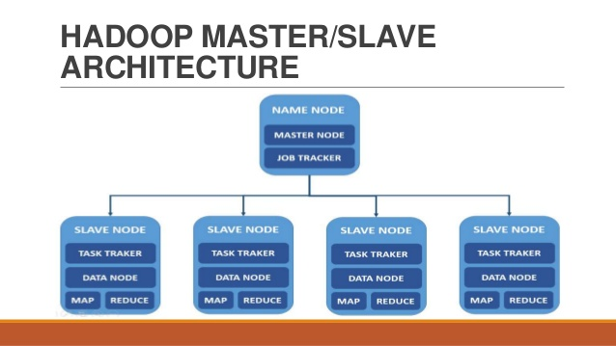
HDFS uses a master/slave architecture where master consists of a single NameNode that manages the file system metadata and one or more slave DataNodes that store the actual data. HDFS component creates several replicas of the data block to be distributed across different clusters for reliable and quick data access. HDFS comprises of 3 important components-NameNode, DataNode and Secondary NameNode.

Slide 9
MAP REDUCE
MapReduce is a framework using which we can write applications to process huge amounts of data, in parallel in a reliable manner.
In a MapReduce program, Map() and Reduce() are two functions. The Map function performs actions like filtering, grouping and sorting. While Reduce function aggregates and summarizes the result produced by map function.
Shuffle and Sort- Output from the mapper is sorted by key.All values with the same key are guaranteed to go to the same machine.
The result generated by the Map function is a key value pair (K, V) which acts as the input for Reduce function.
The reducer stage is the combination of the Sort and Shuffle stage and the Reduce stage.

Slide 10
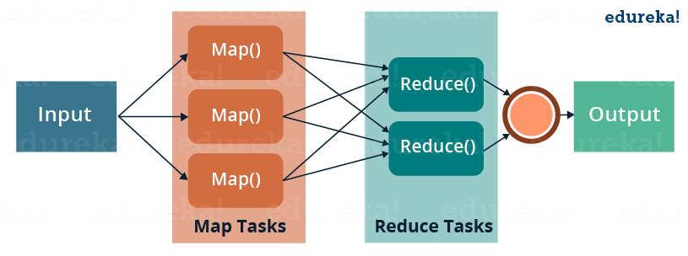
MapReduce consists of two distinct tasks – Map and Reduce.
First is the map job, where a block of data is read and processed to produce key-value pairs as intermediate outputs.
The output of map job (key-value pairs) is input to the Reducer.
The reducer stage is the combination of the Sort and Shuffle stage and the Reduce stage.
The reducer receives the key-value pair from multiple map jobs.

Slide 11
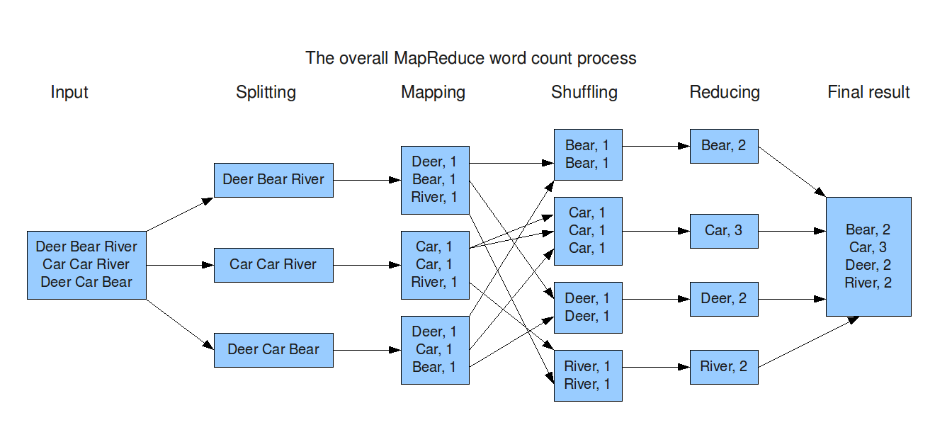

Slide 12
Classes and their methods that are involved in the operations of MapReduce programming:
JobContext Interface- defines different jobs in MapReduce. It gives you a read-only view of the job that is provided to the tasks
<KEYIN, VALUEIN, KEYOUT, VALUEOUT>
2. Job Class- Job class is the main class that implements the JobContext interface. It allows the user to configure the job, submit it, control its execution, and query the state.
3. Mapper class - The Mapper class defines the Map job. Maps input key-value pairs to a set of intermediate key-value pairs.
4. The Reducer class defines the Reduce job in MapReduce. It reduces a set of intermediate values that share a key to a smaller set of values.

Slide 13
PARTITIONER AND COMBINER
A partitioner works like a condition in processing an input dataset. The partition phase takes place after the Map phase and before the Reduce phase.
Partitioner distributes the output of the mapper among the reducers.
The Combiner class is used in between the Map class and the Reduce class to reduce the volume of data transfer between Map and Reduce.
Usually, the output of the map task is large and the data transferred to the reduce task is high.
The combiner in MapReduce is also known as ‘Mini-reducer’. IT runs on the output of the map phase and used as a filteration or aggregation step to lessen the amount of data passed to the reducer phase

Slide 14
HIVE
Hive is a data warehouse infrastructure tool to process structured data in Hadoop. It resides on top of Hadoop to summarize Big Data, and makes querying and analyzing easy.
In Hive, tables and databases are created first and then data is loaded into these tables.
Hive as data warehouse designed for managing and querying only structured data that is stored in tables.
Hadoop processing with SQL
By using Hive, we can perform some peculiar functionality that is not achieved in Relational Databases. For a huge amount of data that is in peta-bytes, querying it and getting results in seconds is important. And Hive does this quite efficiently, it processes the queries fast and produce results in second's time.
Hive supports "READ Many WRITE Once

Slide 15
PIG
Apache Pig is an abstraction over MapReduce.
Used to analyze larger sets of data representing them as data flows. Pig is generally used with Hadoop
To analyze data using Apache Pig, programmers need to write scripts using Pig Latin language. All these scripts are internally converted to Map and Reduce tasks.
Apache Pig has a component known as Pig Engine that accepts the Pig Latin scripts as input and converts those scripts into MapReduce jobs.

Slide 16
Apache Pig uses multi-query approach, thereby reducing the length of codes.
Pig Latin is SQL-like language
Apache Pig provides many built-in operators to support data operations like joins, filters, ordering, etc. In addition, it also provides nested data types like tuples, bags, and maps.
FEATURES:
operators − It provides many operators to perform operations like join, sort, filer, etc.
Ease of programming − Pig Latin is similar to SQL and it is easy to write a Pig script if you are good at SQL.
Optimization opportunities − The tasks in Apache Pig optimize their execution automatically, so the programmers need to focus only on semantics of the language.

Slide 17
SQOOP
Sqoop is a tool designed to transfer data between Hadoop and relational database servers.
It is used to import data from relational databases such as MySQL, Oracle to Hadoop HDFS, and export from Hadoop file system to relational databases.

